Slide 1
Liberation war of bangladesh
Non-cooperation Movement-Quest for Constitutional Solution-Genocide of March-The Beginning of the Liberation War

Slide 2
Topographical Situation
Separated by 1600 km and India was surrounded by 3 sides
Bay of Bengal was in South
The West is alluvial soil divided by four natural zones-Padma, Meghna, Jamuna and Brahmaputra
There are hundreds of Water ways and marshy land
There are two formidable forests-Sunderban and Modhupur in the North of Tangail
Almost every year flood inundates vast areas, disrupting all means of communication

Slide 3
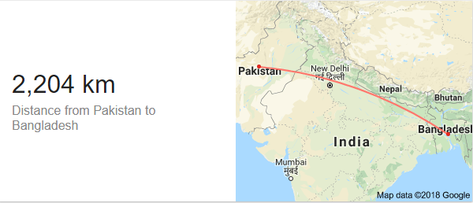

Slide 4
Non-cooperation Movement
1. The Election of 1970 and the Unwillingness of the Government-
The majority of AL in national assembly , 169 out of 313
PPP became the major party in West Pakistan having 88 of 138 seats
In East Pakistan provincial assembly AL got 298 out of 310 seats
West Pakistani elites got afraid and started to procrastinate to transfer the power
2. The Action of the Students and Mass People-
1st March- The session of National Assembly was adjourned for an indefinite time as a result all walks of people reacted severely, Pak army were attacked in several areas by the Mob. Many People died and wounded in these clashes
3rd March- ‘Swadin Bangla Chattra Sangram Parishad’ was formed having representation from both DUCSU and Chattra League.

Slide 5


ASM ABDUR ROB-VP
Abdul Kuddus Makhon-GS
NUR-E-ALAM-SIDDIQUI-PRESIDENT
SHAHJAHAN SIRAJ-GENERAL SECRETARY

Slide 6
3rd March- This organization called country wide hartal and in the same day the flag of Bangladesh was hoisted for the first time in Arts Building premises. In a student meeting at Paltan maidan where Bangabandhu was the chief guest urged people to extend their support for the success of hartal from 4th to 6th march.
4th March to 6th March- All walks of people showed an impressive support for the hartal. Programs were boycotted by the artists of Betar and TV. Students-Teachers –Lawyers were also expressed their solidarity with the non-cooperation movement . The movement got a momentum and Yahyah Khan became very frightened.
6th March- As a result in a Betar speech Yahyah khan called for the session of National Assembly on 25th March but the ruffled people along with sheikh Mujibur Rahman didn’t trust him anymore.
7th March- Awami League called for a public gatherings in Suhrawardy Uddayan .

Slide 7
Quest for Constitutional Solution
The Historic 7th March speech and Its Importance-
On 7th march at a huge public gathering of more than a million people at the ramna race course in Dhaka. Sheikh Mujib announced four pre-conditions for attending the session of National Assembly-
Immediate transfer of power to the elected representatives of the people, before the assembly met on 25th march, 1971
Withdrawal of Martial Law
Enquiry into the recent shootings upon the Bengalis
Immediate return of the troops to the barracks

Slide 8
Besides the above demands, some others declarations were also announced. Sine die closure of educational institutions and offices and adalats.
He also gave several directives for a civil disobedience movement, instructing that:
1. People should not pay taxes;
2. Government servants should take orders only from him;
3. The secretariat, government and semi-government offices, and courts in East Pakistan should observe strikes, with necessary exemptions announced from time to time;
3. Only local and inter-district telephone lines should function;
4. Railways and ports could continue to function, but their workers should not co-operate if they were used to repress the people of East Pakistan.
Pak authority was taken the gathering very seriously and prepared to attack if any declaration from BB in regards to independence, So in an indirect way Bangabandhu declared the independence indirectly .
The speech lasted about 19 minutes and concluded with, "Our struggle, this time, is a struggle for our freedom. Our struggle, this time, is a struggle for our independence. Joy Bangla!“ It was a de facto declaration of Bangladesh's independence.
International media had descended upon East Pakistan for the speech amidst speculation that Sheikh Mujib would make a unilateral declaration of independence from Pakistan. However, keeping in mind the failures of Rhodesia's Unilateral Declaration of Independence and of the Biafra struggle in Nigeria, he did not make a direct declaration. Nevertheless, the speech was effective in giving Bengalis a clear goal of independence.

Slide 9
7th March-Training was started in Dhaka City and Tikka was appointed as the governor of East Pakistan
8th March- Training was started in all over the country ( by EOTC Cadets) and continued upto 25th March.
Many committees were formed in District, Sub-Disdrict, Thana and Even to the union level.

Slide 10
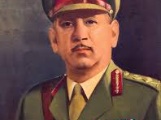
THE EXPANSION OF NON-COOPERATION MOVEMENT
7th March-Training was started in Dhaka City and Tikka was appointed as the governor of East Pakistan
8th March- Training was started in all over the country ( by EOTC Cadets) and continued upto 25th March.
Many committees were formed in District, Sub-Disdrict, Thana and Even to the union level.

Slide 11
From 1st of March to the onwards days, the policy of non-cooperation was very successful
7th march- Tikka was appointed
10th march- in a millitary order all the officers were requested to join in the work
13 march- Martial law was again introduced
14 march- Bhutto demanded the distribution of power and Bangabandhu placed a directive of 5 points.

Slide 12


Slide 13
`
Bangabandhu Gave 35 Directives to Run the State
Tajuddin Ahmad, on behalf of Bangabandhu and Awami League, declared the 35 point instructions for conducting the affairs of the government, which appeared in major newspapers on March 15, 1971. We can say that the direct control of the Pakistan government over East Pakistan virtually ceased after the directives of Bangabandhu Sheikh Mujibur Rahman. “In fact, Bangabandhu took the administrative power of Bangladesh (the then East Pakistan) through the 35 directives”,
Professor Rehman Sobhan in his memoir “Untranquil Recollections: The Years of Fulfilment” wrote that Bangladesh effectively got independence on March 5, the day when the political supremacy came to Bangabandhu’s hand. After that day, whatever Yahya said, the people in Bangladesh saw those as armed aggression against the sovereignty of the country. On the other hand, people took the 35 directives of Bangabandhu as the must follow command to protest against the oppression of Pakistani ruler and to get freedom from their repression.
The directives were related to all major areas including administration, education, law and order, port operation, foreign trade, communication, agriculture, services, development, industries, flood control, bank and treasury, tax collection, insurance and trade and business and payment of pension for retired employees and salaries of government and semi-government staff and primary school teachers.
If we recall the public response to the directives and the 7th March speech of Bangabandhu, we find that he became the de-facto president and took effective control of the entire country during the period when the military government of Pakistan had its control only inside cantonments. Bangabandhu in his directives called for continuing indefinite shutdown, but was very cautious about maintaining law and order and keeping internal and external trade, farm and development activities and all other financial activities unhindered.
He kept railways, roads and water transports, port and media and hospitals out of the purview of the non-stop nation-wide strike and advised all concerned to continue their duties. Banks, telecommunication and postal services were also advised to operate only to provide their services to the people of the-then East Pakistan. But, the people involved with power, gas and water supplies had been asked to be on duty so that people don’t suffer.

Slide 14
In a nutshell; The 35 directives
Governmental Departments, Secretariat, High-Court, Semi-autonomous institutions and educational institutions will be closed .
DC and M. Ad. Will be refrained from opening offices and in a collaboration with AL and sangram parishad, will try to maintain law and order.
Police- the same of above
Radio, Television and Newspapers will be opened but………….
No taxes and revenues to be paid

Slide 15
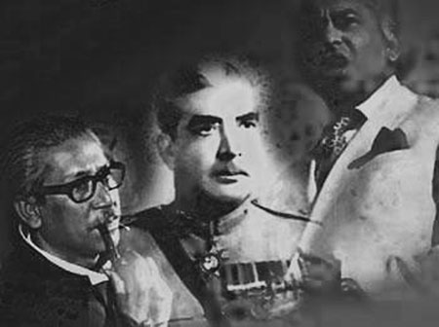
Yahyah-Bhutto-Mujib Talk
Yahyah arrived in Dhaka and asked Mujib to sit for discussion
16th March- Discussion was started
22th March- Bhutto came into Dhaka and joined with the Duo ( but 19th march attack in joydebpur made it impossible to reach into a decision)
23rd March- On republic day, most of the houses hoisted BD flag
24th March- The last effort from AL leaders for solution
25th March- The discussion was unfinished and Yahyah left Dhaka after orderning to attack the Bengalis

Slide 16
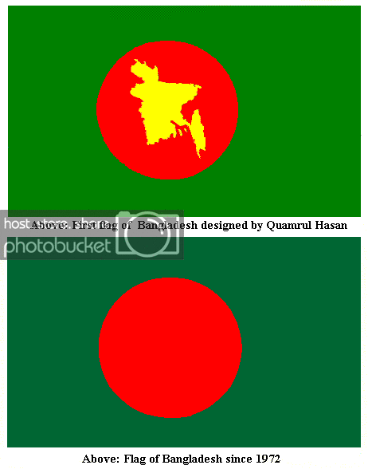
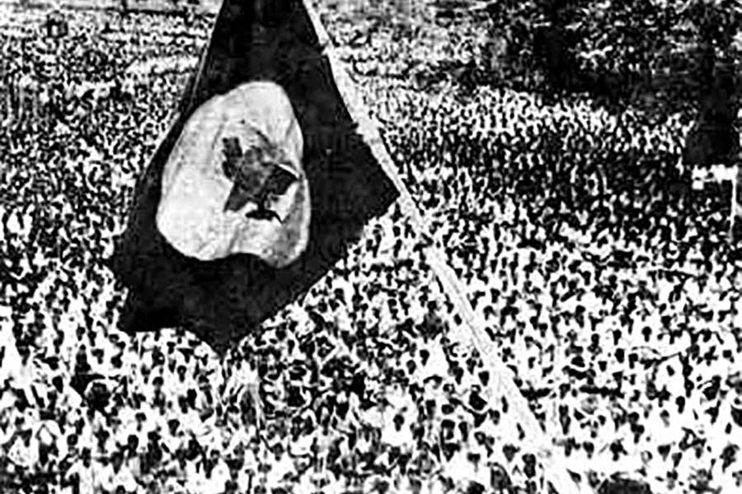
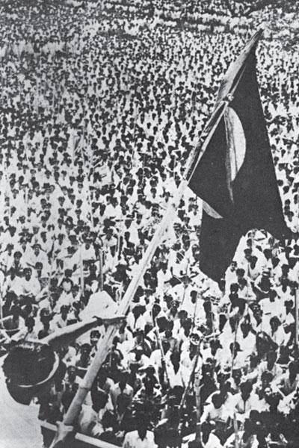
National Flag
Flag was hoisted in DU Arts Building
The Evolution of Flag

Slide 17
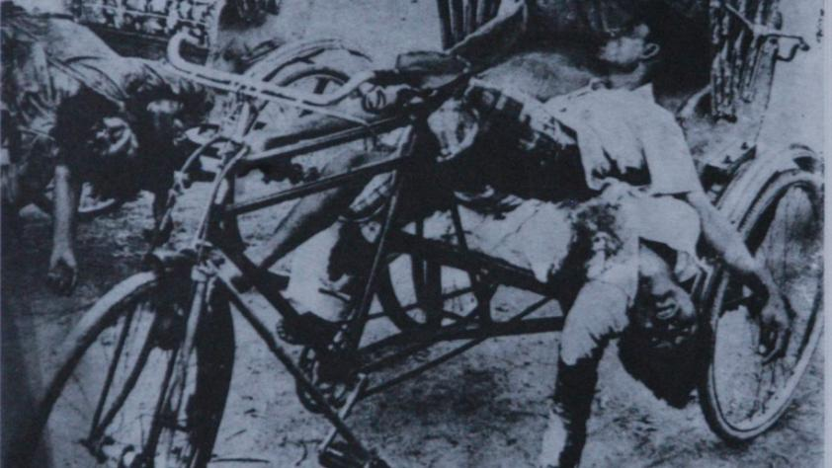

Slide 18
25th March and Declaration of Independence
On 25th March night in 1971, the Pakistani military junta launched the “Operation Searchlight” and mercilessly killed the Bangalee members of East Pakistan Rifles and police, students and teachers as well as thousands of common people in Dhaka city.
Jagannath Hall, a non-Muslim dormitory of Dhaka University, and Iqbal Hall, now Sergeant Zohurul Haq Hall, Pilkhana, Rajarbagh Police Lines, and Hindu-dominated areas of Old Dhaka were the main targets of the operation.
Another book, "Rifle Roti Awrat" by Prof Anwar Pasha, narrated the barbarism carried out by the Pakistani troops on Dhaka University campus.
On the Dhaka University campus, the occupation forces on that night carried out a planned massacre of 200 students, 10 teachers and 12 employees.
Armed with heavy weapons such as tanks, automatic rifles, rocket launchers, heavy mortar, light machine gun, Pak soldiers encircled Dhaka University from east (unit 41), from south (unit 88) and from north (unit 26).
The first target of Operation Searchlight was Zahrul Hoque Hall as the then Non-cooperation Movement was organised under the banner of "Independent Bangladesh Students Movement Council" from that dormitory.
By March 25, all leaders of Chhatra League had left the hall.
After 12 o'clock, the army attacked Jagannath Hall with shelling of mortar and nonstop gun firing.

Slide 19
They entered the dormitory through north and south gates and killed students indiscriminately in each room. Around 34 students were killed. Some students of Jagannath Hall were resident of Ramna Kali Bari.
Archer Blood, the then consul general of US embassy in Dhaka, wrote in his book "The Cruel Birth of Bangladesh" that fire broke out at Rokeya Hall, girls' dormitory and, when the students tried to escape, the military started firing. From the conversation of military control room and army unit 88, a total of 300 students death was estimated."
The Operation Searchlight was one of very few military operations in post-World War-II history, which ultimately had been planned against civilians, just to kill a smart percentage of them and to scare the survivors.
About that night, American journalist Robert Payne wrote that at least 7000 people were killed and 3000 others were arrested in the crackdown.
In the wake of the Pak army action, Bangabandhu Sheikh Mujibur Rahman declared independence of Bangladesh through EPR wireless at 00-30 hours on March 26 (the night following March 25) in 1971 from his Road-32 residence at Dhanmondi in Dhaka.
The great leader also called upon the people to build a united resistance against the Pakistani occupation forces. Later, the military junta, in a bid to stop the legitimate movement of the Bangalees, arrested him on that night following his declaration of the country's independence.
Later, Bangabandhu was taken to the then West Pakistan where he had to spend long nine months in a Pakistani jail.
Following the declaration, the whole nation, except a few pro-Pakistani elements, joined the War of Liberation. And ultimately Bangladesh was freed from the Pakistani occupation forces with their surrender at the Race Course Maidan, later renamed as Suhrawardy Udyan, on December 16 in 1971.

Slide 20
Declaration of Independence
26 March, it is claimed that a message from, bangabandhu sheikh mujibur rahman declared independence. The message is said to have been made available to EPR shortly after midnight and it was duly broadcast through EPR radio communication system. Because the system was VHF frequency crystal controlled, not very many people did listen to the declaration. The message went:
‘This may be my last message, from today Bangladesh is independent. I call upon the people of Bangladesh wherever you might be and with whatever you have, to resist the army of occupation to the last. Your fight must go on until the last soldier of the Pakistan occupation army is expelled from the soil of Bangladesh and final victory is achieved’
Major ziaur rahman of East Bengal Regiment declared independence the following day on behalf of Bangabandhu (27 March);'
‘I Major Zia, Provisional Commander-in-Chief of the Bangladesh Liberation Army, hereby proclaims, on behalf of Sheikh Mujibur Rahman, the independence of Bangladesh.
'I also declare, we have already framed a sovereign, legal Government under Sheikh Mujibur Rahman, which pledges to function as per law and the constitution. The new democratic Government is committed to a policy of non-alignment in international relations. It will seek friendship with all nations and strive for international peace. I appeal to all Government(s) to mobilige (sic) public opinion in their respective countries against the brutal genocide in Bangladesh. The Government under Sheikh Mujibur Rahman is sovereign (and) legal Government of Bangladesh and is entitled to recognition from all democratic nations of the world.

